Slide 1
Types of Division
A supplemental lesson for AP CSP

Slide 2
Doing math in Python
Python contains several built-in math functions.
You have used some of these functions in your code:
  abs()
  round()
Some other built-in functions include:
  max()
  min()

Slide 3
Doing math in Python
Python follows the order of operations in math
Multiplication and division have a higher precedence than addition and subtraction.
Python has more than one way to divide numbers.
Let’s take a look:
  Look at the division problems on the next slide.
  Fill in the mathematical operator for each equation.

Slide 4
Part 1: The Answers Are …
7 ░ 4 = 1.75 7 ░ 4 = 1 | 5 ░ 3 = 1.667 5 ░ 3 = 1
13 ░ 5 = 2.6 13 ░ 5 = 2 | 9 ░ 2 = 4.5 9 ░ 2 = 4

Slide 5
Types of Division
A single / is decimal division
Two // is integer division
// gives the whole number only in the division problem
Examples:
  8 / 4 = 2.0
  8 // 4 = 2
  6 / 5 = 1.2
  6 // 5 = 1
  5 / 6 = .83
  5 // 6 = 0
1
4⟌7
7 // 4 = 1

Slide 6
Part 2: The Answers Are …
7 / 4 = 1.75 7 // 4 = 1 7 ░ 4 = 3 | 5 / 3 = 1.667 5 // 3 = 1 5 ░ 3 = 2
13 / 5 = 2.6 13 // 5 = 2 13 ░ 5 = 3 | 9 / 2 = 4.5 9 // 2 = 4 9 ░ 2 = 1

Slide 7
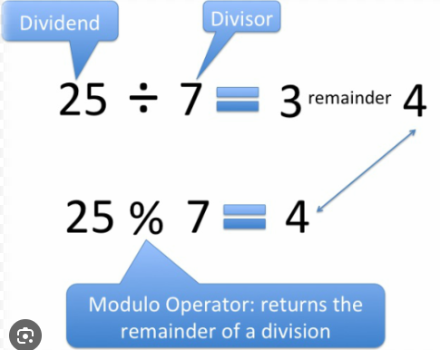
Modulo Division
% gives the remainder of integer division
r 3
1
4⟌7
7 % 4 = 3

Slide 8
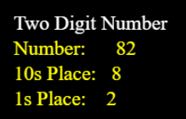
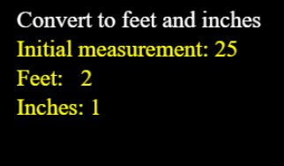
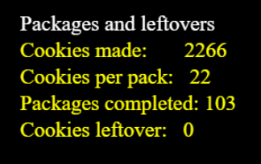
Part 3: Modulo division
Limits the number of possible answers
  Any_number % 3 can only be 0, 1, or 2
Lets you separate place values of numbers
Is used for numerical conversions
Gives you “leftovers”
And much, much more!

Slide 9
Modulo division
Let’s use modulo division in a current CodeX program.
In CodeSpace, go to the sandbox.
Open the Billboard_functions program.
Go to File → Save As… and rename the file Billboard_modulo
Run the program and make sure it has no bugs.

Slide 10
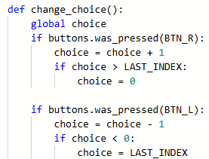
Modulo division
The change_choice() function uses an if statement to avoid an “Index out of range” error.

Slide 11

Modulo division
Use modulo division instead of an if statement to keep the index in the range.
Use a second variable for the index.
Near the top of the program, delete the constant LAST_INDEX and add a variable for index.

Slide 12
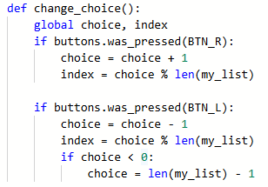
Modulo division
Go the the change_choice() function.
Add a global index.
Then change the if statements to: index = choice % len(my_list)
What are the possible values for index?

Slide 13
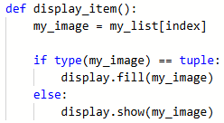
Modulo division
Now use the variable index in display_item() instead of choice.
Run the code. Does it work like you expect it to?

Slide 14
Part 4: Check your understanding
Given: number % 10 What are the possible answers? | Given: number % 5 What are the possible answers? | Given: number % 3 What are the possible answers?

Slide 15
Part 4: Check your understanding
Given: number % 10 What are the possible answers? 0, 1, 2, 3, 4, 5, 6, 7, 8, 9 | Given: number % 5 What are the possible answers? 0, 1, 2, 3, 4 | Given: number % 3 What are the possible answers? 0, 1, 2

Slide 16
Part 4: Check your understanding
Evaluate: 10 // 7 = 10 % 7 = | Evaluate: 10 // 3 = 10 % 3 = | Evaluate: 9 // 6 = 9 % 6 =

Slide 17
Part 4: Check your understanding
Evaluate: 10 // 7 = 1 10 % 7 = 3 | Evaluate: 10 // 3 = 3 10 % 3 = 1 | Evaluate: 9 // 6 = 1 9 % 6 = 3

Slide 18
Part 4: Check your understanding
Evaluate: 10 // 5 = 10 % 5 = | Evaluate: 4 // 5 = 4 % 5 = | Evaluate: 1 // 2 = 1 % 2 =

Slide 19
Part 4: Check your understanding
Evaluate: 10 // 5 = 2 10 % 5 = 0 | Evaluate: 4 // 5 = 0 4 % 5 = 4 | Evaluate: 1 // 2 = 0 1 % 2 = 1

